Slide 1




ExcelR Final Project
Adventure Works
Sales Performance Project
Excel | MySQL | Tableau | Power BI
Presented by: Group - 6 ( Ranjith Kumar V, Roshini A, Shreyash Shende, Soundarya P, Ruturaj Rhatwal, Pushpa P )
ExcelR Data Analyst Project
Adventure Works Sales Performance Project | July 2026
Excel
MySQL
Tableau
Power BI

Slide 2

Company Overview
Who is Adventure Works?
Global Retailer
Adventure Works is a multinational manufacturer and retailer of bicycles, components, clothing, and accessories.
Multi-Region Operations
Products sold across North America, Europe, and the Asia-Pacific region through online and reseller channels.
Diverse Product Range
Categories include Mountain Bikes, Road Bikes, Touring Bikes, and a wide range of Accessories.
Project Objective
Analyze sales performance, customer behavior, and regional trends to drive data-backed decisions.

Slide 3




Project Objectives
01
02
Data Cleaning & Transformation
Performance Analysis
Clean raw sales data, fix missing values, standardize formats, and prepare for analysis.
Analyze customer behavior, product sales, and regional performance across all years.
03
04
Interactive Dashboards
Business Insights
Build dynamic dashboards in Tableau and Power BI with filters, slicers, and drill-downs.
Extract actionable insights and strategic recommendations to support decision-making.

Slide 4
Tools & Technologies Used
End-to-end BI stack for this project
Microsoft Excel
MySQL
Tableau
Power BI
Data Cleaning
Data Storage
KPI Cards
DAX Measures
Remove duplicates, fix missing values
Imported AdventureWorks tables
Total Sales, Profit, Orders
YoY, MoM, cumulative metrics
Pivot Tables
Joins
Line Charts
Drill-Through
Summarize sales by year, month, category
Linked Fact & Dimension tables
Month-wise & Year-wise trends
Product & territory deep-dives
VLOOKUP / IF
GROUP BY
Maps
KPI Tiles
Data enrichment and conditional logic
Aggregated sales by year, country
Sales by country/region
Sales, Profit, Customers
Charts
Subqueries
Filters
Slicers
Year-wise, product-wise visualizations
Top customers, top products
Interactive slicers & parameters
Year, Month, Category, Country

Slide 5
Project Workflow
End-to-end data pipeline from raw data to business insights
1
2
3
4
5
6
Raw Dataset
Excel Cleaning
MySQL Database
Tableau Dashboard
Power BI Dashboard
Business Insights
AdventureWorks Data Worksheet
Excel + SQL source files
▶
Remove errors
Standardize & format data
▶
Import tables
Run SQL queries & joins
▶
Interactive visuals
Sales trends & maps
▶
KPI tiles & DAX
Slicers
▶
Recommendations
& Strategic decisions

Slide 6
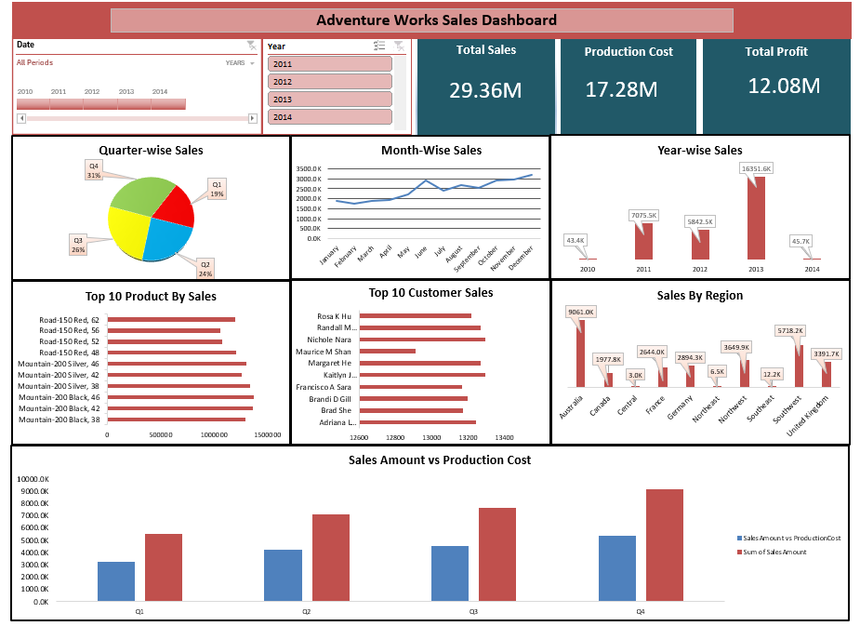




Excel Analysis & Dashboard
Data cleaning, pivot tables & charts
Data Cleaning
Removed duplicates, fixed null values, corrected date formats and data types.
Pivot Tables
Monthly sales summary, year-wise revenue breakdown, product category analysis.
Lookup Functions
VLOOKUP to enrich sales data with customer and product details.
Charts Created
Bar, line, and pie charts for Year-wise Sales, Monthly Trends, and Product Performance.

Slide 7
MySQL Analysis
Data storage, joins, aggregations & business queries
Tables Imported
Aggregations
-- Year-wise Sales Summary
FactInternetSales, DimCustomer,
DimProduct, DimDate, DimGeography
SUM, COUNT, AVG with
GROUP BY Year, Country, Category
SELECT
f.OrderYear AS [Year],
SUM(f.SalesAmount) AS TotalSales,
Joins Used
Business Queries
SUM(f.OrderQuantity) AS TotalOrders
INNER JOIN on CustomerKey,
ProductKey, DateKey
Top 10 customers, Top products,
Sales by region & seasonality
FROM FactInternetSales f
JOIN DimDate d
ON f.OrderDateKey = d.DateKey
GROUP BY f.OrderYear
ORDER BY f.OrderYear;

Slide 8
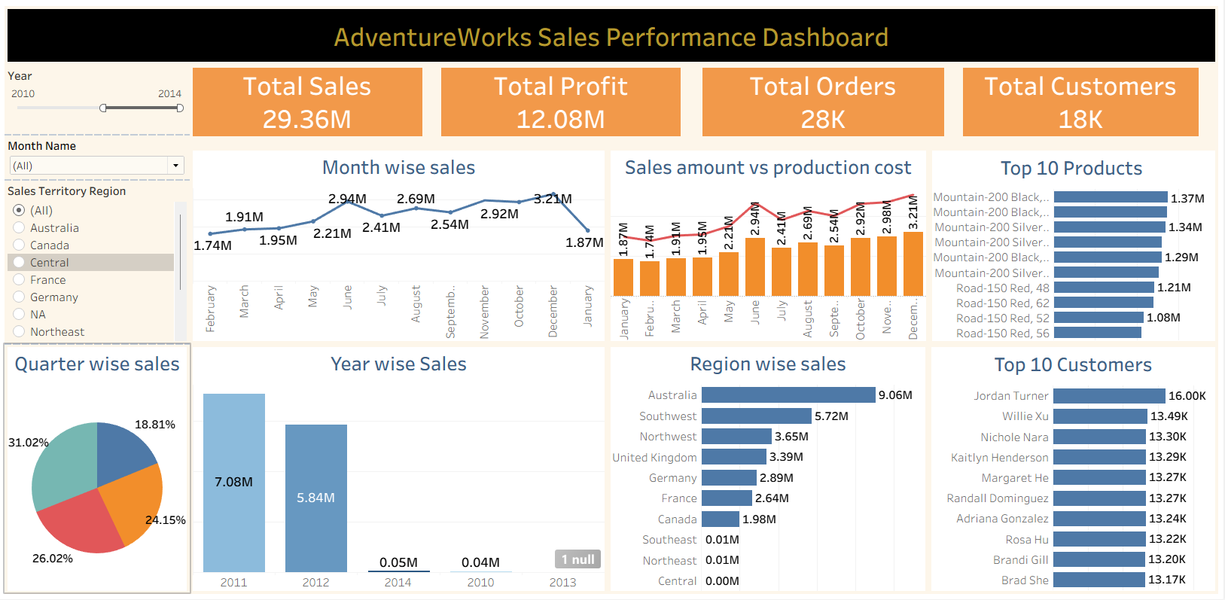
Tableau Dashboard
Interactive sales visualizations & KPIs
KPI Cards
Total Sales 29.36M · Profit 12.08M · Total Orders 28K & Total Customers 18K
Monthly Trend
Line chart showing month-wise sales pattern across the year
Year-wise Sales
Bar chart: 2010–2014 with 2013 peak at 16.34M
Sales by Country
Region breakdown: Australia, USA, UK, Germany, France, Canada
Top 10 Products
Mountain-200 series leads with 1.37M in top spot
Interactive Filters
Quarter, Country, Month slicers for dynamic exploration

Slide 9
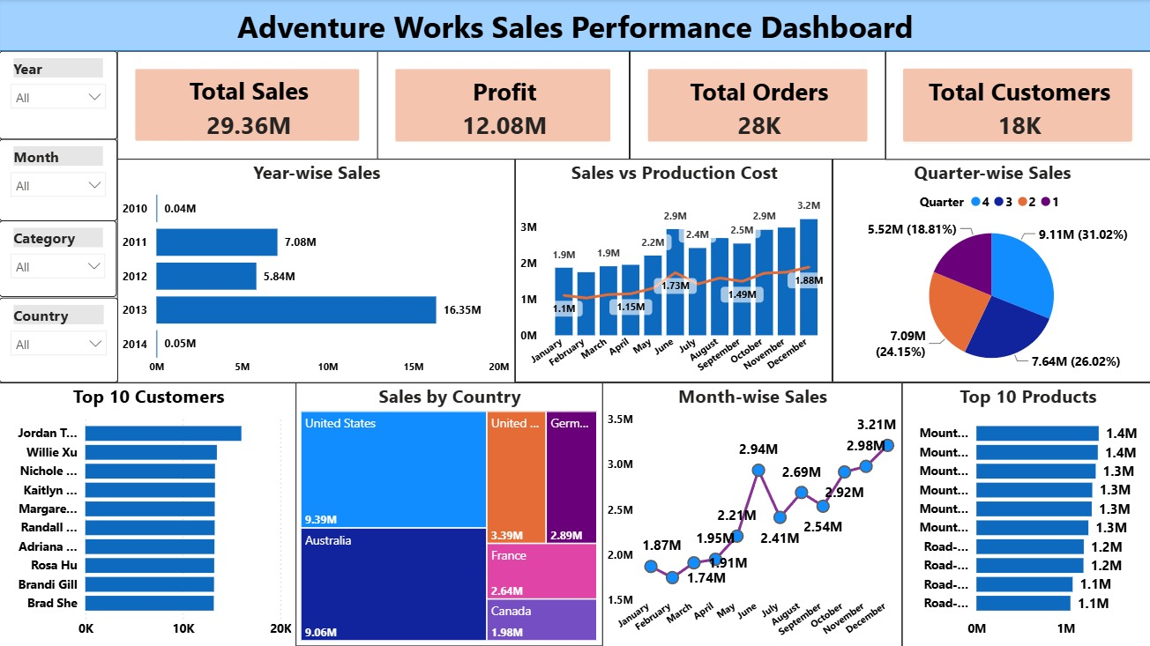
Power BI Dashboard
Dynamic KPI tiles, slicers & drill-down capability
29.36M
Total Sales
12.08M
Profit
28K
Total Orders
18K
Total Customers

Slide 10




Key Business Insights
What the data revealed
Sales Growth Peak — 2013
North America Leads
Sales surged to 16.35M in 2013, representing the highest annual revenue across all years (2010–2014).
United States (9.39M) and Australia (9.06M) together account for over 60% of total global sales.
Bikes Drive Revenue
High-Value Customers
Mountain and Road bikes are the primary revenue generators; Accessories drive highest transaction frequency.
Top 10 customers (Jordan T., Willie Xu, Nichole…) contribute disproportionately to overall order value.
Seasonal Demand Pattern
Online vs Reseller Margins
Consistent sales spikes observed in Q2 and Q4 driven by seasonal buying behavior globally.
Direct online channel delivers higher profit margins (41%) compared to reseller/wholesale channels.

Slide 11
Strategic Recommendations
Actionable next steps derived from data insights
01
Inventory Bundling
Bundle accessories (helmets, cage) with bike purchases. 65% affinity rate makes this a proven upsell strategy.
02
Expand Outdoor Categories
Capitalize on the accessories segment's high transaction frequency by expanding the outdoor product range.
03
Digital Marketing Investment
Reallocate ad spend toward high-income segments in underperforming European markets (France, Germany).
04
Customer Loyalty Programs
Introduce loyalty rewards for repeat customers to retain the top-performing customer cohort and boost LTV.
05
Premium Product Focus
Increase premium SKU offerings in Mountain and Road bike lines where margins are significantly higher.

Slide 12


Challenges Faced
Obstacles encountered and how we overcame them
Data Cleaning Complexity
Relationship Modelling
Inconsistent date formats, duplicate customer records, and null values required extensive Excel preprocessing before analysis could begin.
Creating accurate relationships between Fact and Dimension tables in Power BI required careful key mapping and schema validation.
Complex SQL Joins
Dashboard Design
Multi-table joins across FactInternetSales, DimCustomer, DimProduct, and DimDate required iterative query refinement.
Designing clean, non-cluttered layouts with effective use of color, spacing, and chart types in both Tableau and Power BI.
DAX Calculations
Writing time intelligence measures in Power BI required understanding of DAX context and filter propagation.

Slide 13


Future Scope
Where this project can evolve next
AI Sales Forecasting
Customer Prediction
Use machine learning models to predict future sales trends and seasonal demand.
Build a model identifying at-risk customers using analysis and classification algorithms.
Inventory Optimization
Real-Time Dashboards
Integrate demand forecasting with supply chain data to minimize stockouts and reduce holding costs.
Connect dashboards to live data feeds (Azure Stream Analytics) for real-time performance monitoring.

Slide 14

Conclusion
End-to-end Business Intelligence delivered
Data Pipeline Complete
Successfully extracted, cleaned, and modelled AdventureWorks data through Excel and MySQL.
Dashboards Built
Delivered interactive Tableau and Power BI dashboards with filters, KPIs, and drill-downs.
Insights Generated
Identified key revenue drivers: Bikes, USA/Australia markets, Q2–Q4 seasonality, and affinity bundles.
Recommendations Delivered
Provided 5 strategic recommendations covering bundling, marketing, loyalty, premium products, and forecasting.
BI Workflow Demonstrated
Demonstrated a complete end-to-end Business Intelligence workflow from raw data to business value.

Slide 15
Thank You!
Questions & Answers
Group - 6 ( Ranjith Kumar V, Roshini A, Shreyash Shende, Soundarya P, Ruturaj Rhatwal, Pushpa P )
ExcelR Data Analyst Project
Adventure Works Sales Performance Project | July 2026
Excel
MySQL
Tableau
Power BI

